Slide 1
Cohesive Subgraph Detection
Clique Model
Computer Science and Engineering
Xuemin Lin
The University of New South Wales, Australia
Notes:
Hello, everyone. The title of our paper is “Diversified Top-K Clique Search”, and this is a joint work with Dr. Lu Qin, Prof. Xuemin Lin, Dr. Lijun Chang, and Dr. Wenjie Zhang.

Slide 2
Outline
Clique Model
K-Core vs K-Truss
K-Edge Connected
K-Vertex Connected

Slide 3
Clique
Given a graph G, a clique is a set of nodes such that for any pair of them have an edge
A clique is called maximal clique if there exist no other bigger cliques that contain it
v₁
v₆
v₈
v₀
v₄
v₅
v₉
v₂
v₃
v₇
v₁₀

Slide 4
Application
Community detection
Gene expression and motif discovery
Anomaly detection
Stock market data visualization
Signal transmission analysis
……

Slide 5
Maximal Clique Enumeration
Given a graph G, find all the maximal cliques in G.
NP-Hard Problem
v₆
v₈
v₁
v₀
v₄
v₅
v₉
v₁₀
v₇
v₂
v₃

Slide 6
In-Memory MCE
Bron-Kerbosch Algorithm
First Practical In-Memory MCE Algorithm
In-Memory means all the input and auxiliary data structure can be loaded in main memory during the computation
C. Bron et al., “Algorithm 457: finding all cliques of an undirected graph", Communications of the ACM, 16 (9): 575–577,1973
Based on a recursive backtracking paradigm

Slide 7
I/O Efficient MCE
Why I/O Efficient?
Real graph is massive
Facebook contains 1.32 billion nodes and 140 billion edges
EU-2015 (sub-domain of web graph) contains 1.07 billion nodes and 91 billion edges
Memory is fast but small while disk is slow but large

Slide 8
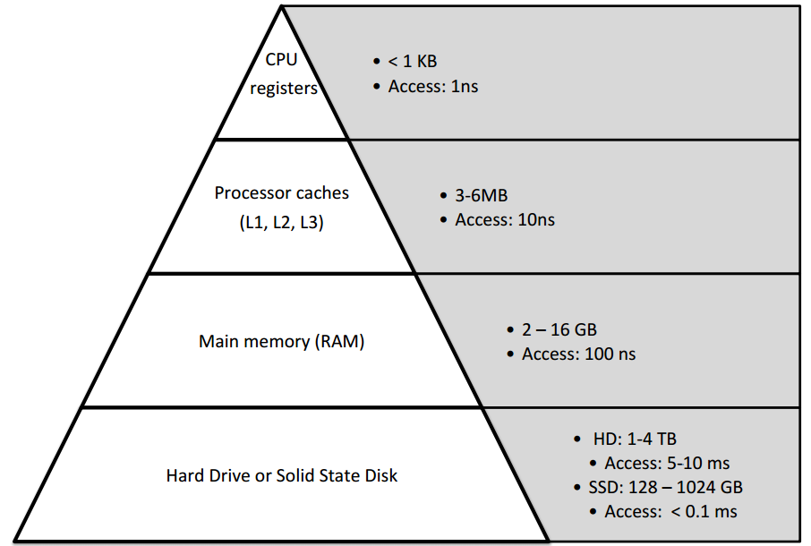
I/O Efficient MCE
Why I/O Efficient?
Memory Hierarchy

Slide 9
Diversified Top-K Clique Search
Traditional models vs diversified top-k clique
v₆
v₈
v₁
v₀
v₄
v₅
v₉
v₁₀
v₇
v₂
v₃

Slide 10
Diversified Top-K Clique Search
Our Solution
treat it as an online k coverage problem
store k maximal cliques in memory
update these k candidate maximal cliques while enumerating cliques
replace small existing cliques with big new cliques

Slide 11
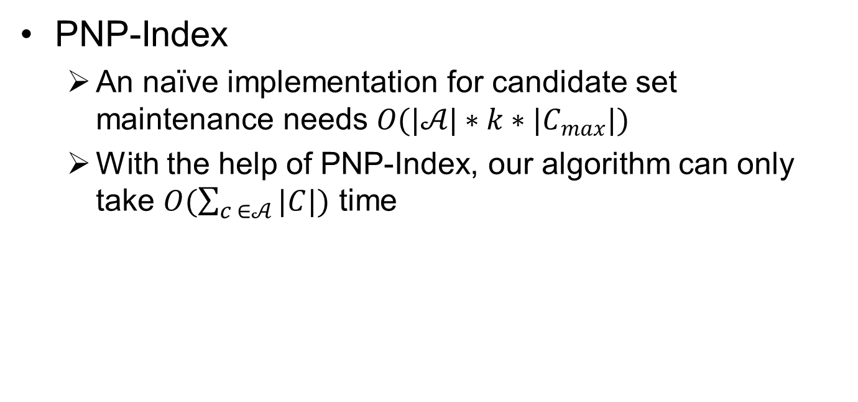
Diversified Top-K Clique Search
PNP-Index
An naïve implementation for candidate set maintenance needs $O(|𝒜|∗k∗|C_{max}|)$
With the help of PNP-Index, our algorithm can only take $O(\sum_{c ∈𝒜}{|C|})$ time

Slide 12
k-Core
Given a graph G, the k-core of G is a subgraph where each node has at least k neighbors (i.e., k adjacent nodes, or a degree of k).
a
e
f
2-core
c
g
b
h
i
d
S. B. Seidman. Network structure and minimum degree. Social networks, 5(3):269–287, 1983.

Slide 13
Maximal k-Core
A k-core C is called maximal if any supergraph of C is not a k-core (i.e., no another k-core which contains C).
a
e
f
Maximal 2-core
c
g
b
h
i
d
S. B. Seidman. Network structure and minimum degree. Social networks, 5(3):269–287, 1983.

Slide 14
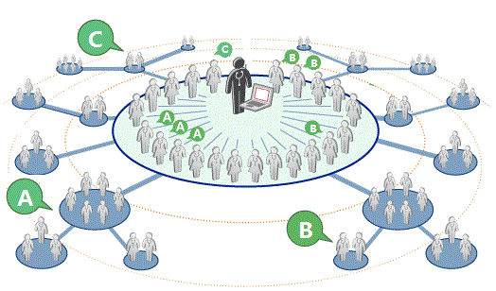
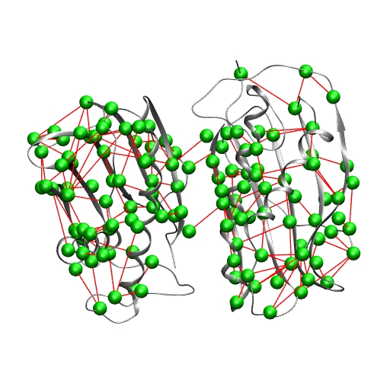
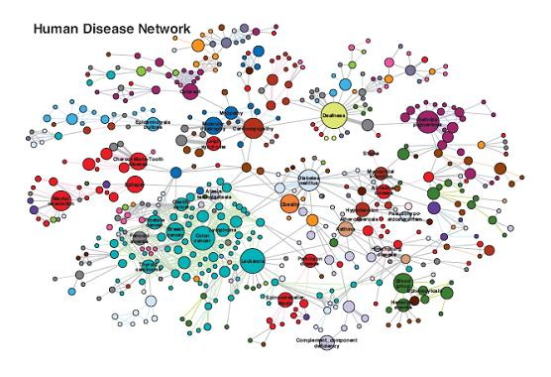
Applications
Community detection
Social contagion
User engagement
Event detection
Network analysis and visualization
Influence study
Graph clustering
Protein function prediction
Human Cerebral Cortex
……

Slide 15
Compute Maximal k-Core
Given a graph G, the maximal k-core of G can be computed by recursively deleting every node and its adjacent edges if its degree is less than k.
Maximal 3-core
e
f
a
c
g
b
h
i
d
S. B. Seidman. Network structure and minimum degree. Social networks, 5(3):269–287, 1983.

Slide 16
k-Core Decomposition
Core number of a node v: the largest value of k such that there is a k-core containing v.
Core decomposition: compute the core number of each node in G.
a
e
f
c
g
b
h
i
1-core
d
3-core
2-core

Slide 17
k-Truss
Given a graph G, the k-truss of G is a subgraph where edge is at least involved in (k-2) triangles.
k-truss is an enhancement of k-core; each vertex of k-truss has a degree at least k-1.
S. B. Seidman. Network structure and minimum degree. Social networks, 5(3):269–287, 1983.

Slide 18
k-edge Connectivity
A graph is k-edge connected if it is still connected after removing any set of (k-1) edges from it
v₁
v₂
v₃
v₄

Slide 19
k-edge Connected Component
A k-edge connected component (k-ECC) of a graph G is a maximal subgraph g of G such that g is k-edge connected
All the examples k=3
v₆
v₁
v₇
v₈
v₂
v₄
v₉
v₁₀
v₁₁
v₃
v₅
v₁₂
v₁₃

Slide 20
Application
Community detection
Social behaviour mining
Graph visualization
Steiner Component Search
Hierarchy Study in Networks
……

Slide 21
k-Vertex Connectivity
A graph is k-vertex connected if it is still connected after removing any set of (k-1) vertex from it
v₁
v₂
v₃
v₄

